Slide 1
scDNA

Slide 2
3’ bias in RNA-Seq

Slide 3
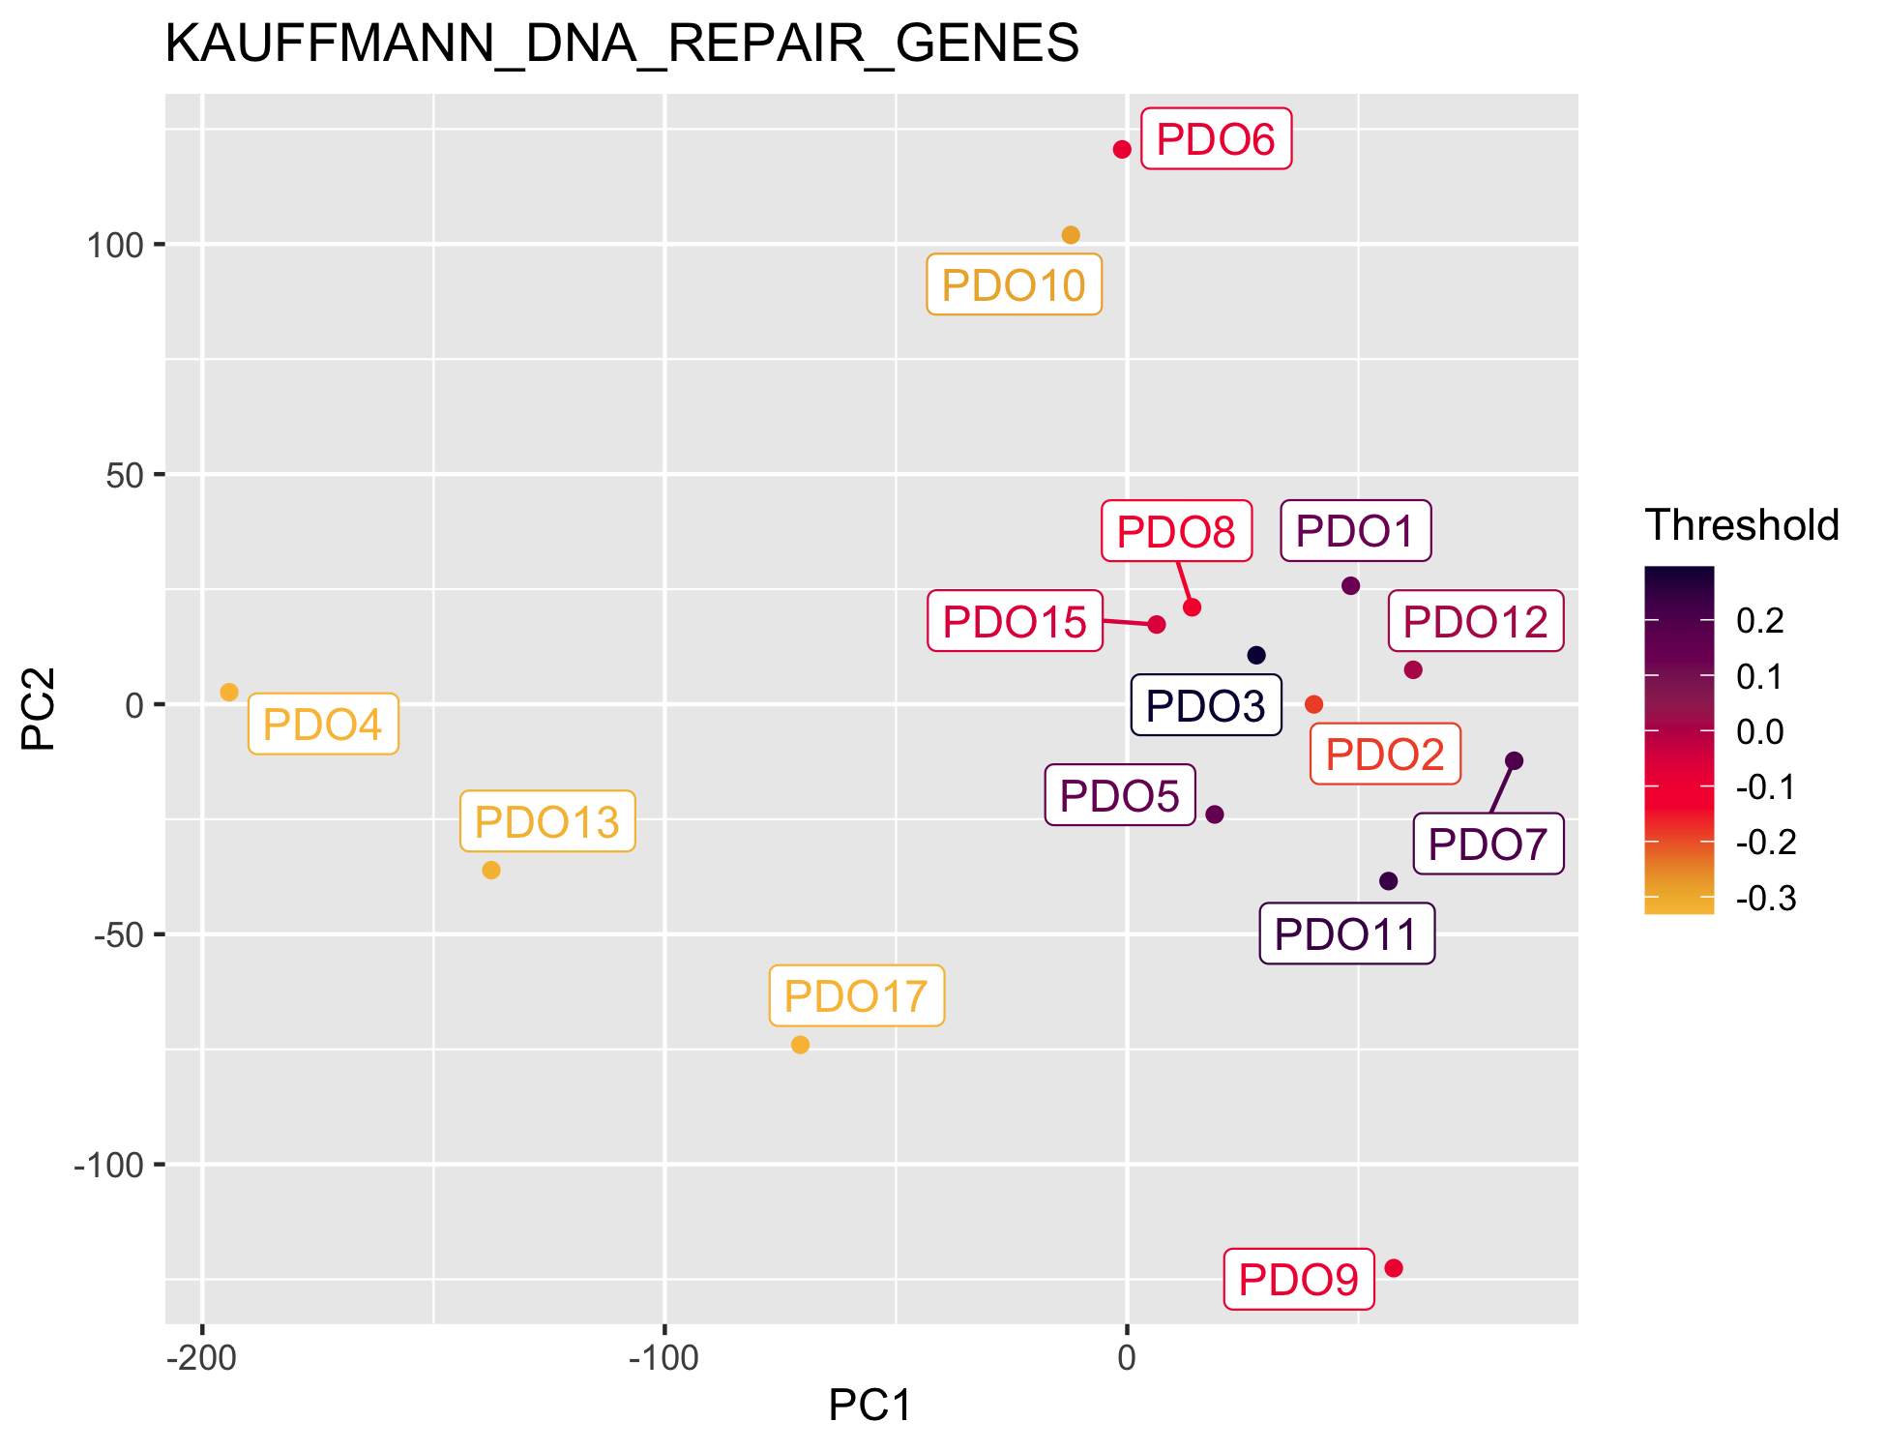

Slide 4
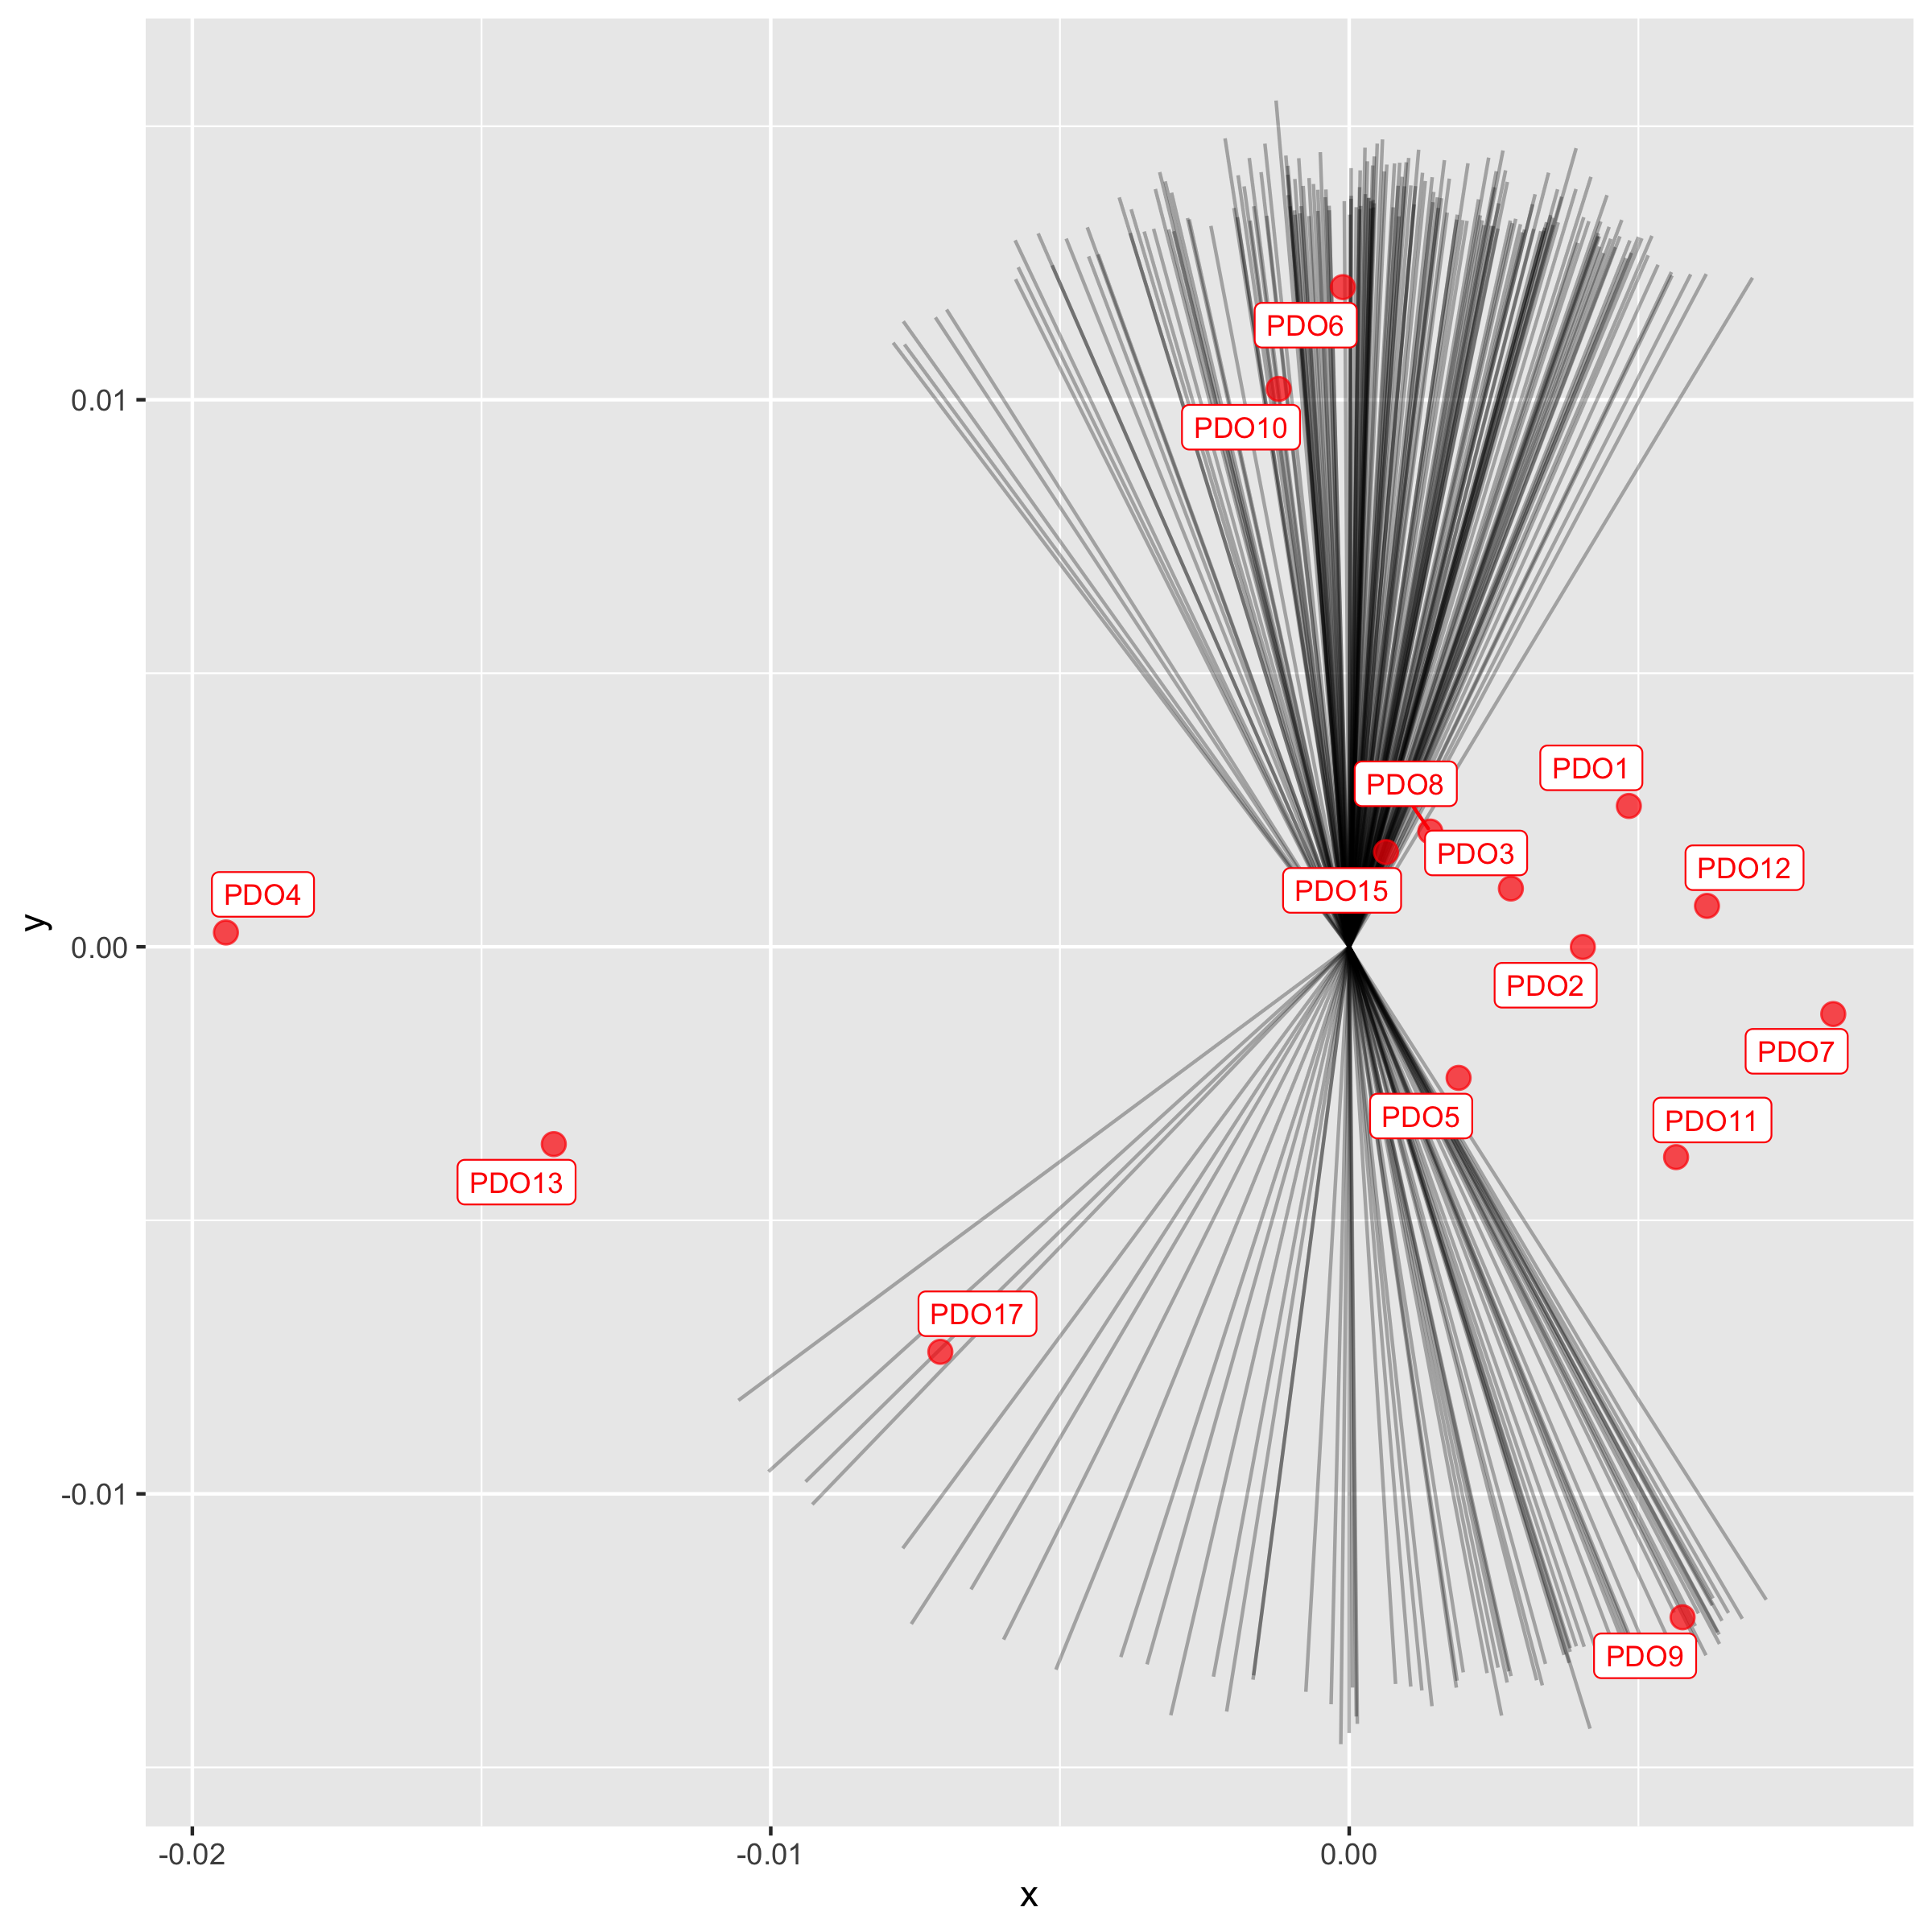
Top length loadings are split in two in opposite directions

Slide 5
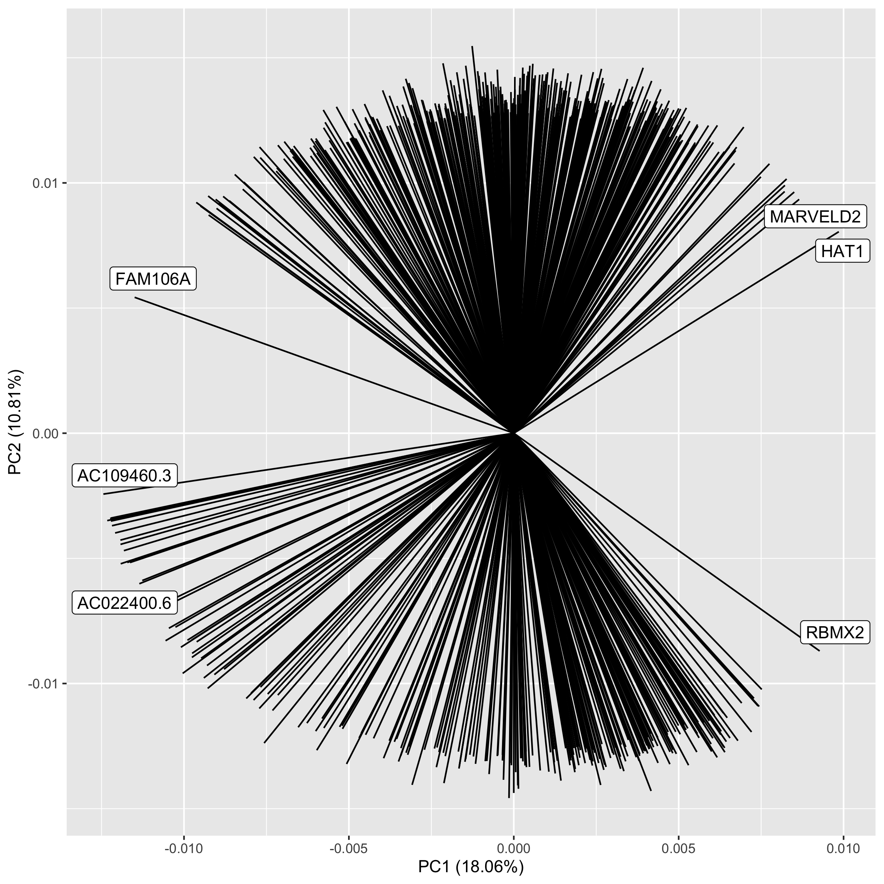
Most variable are also in these two grpups, although the spread is higher

Slide 6
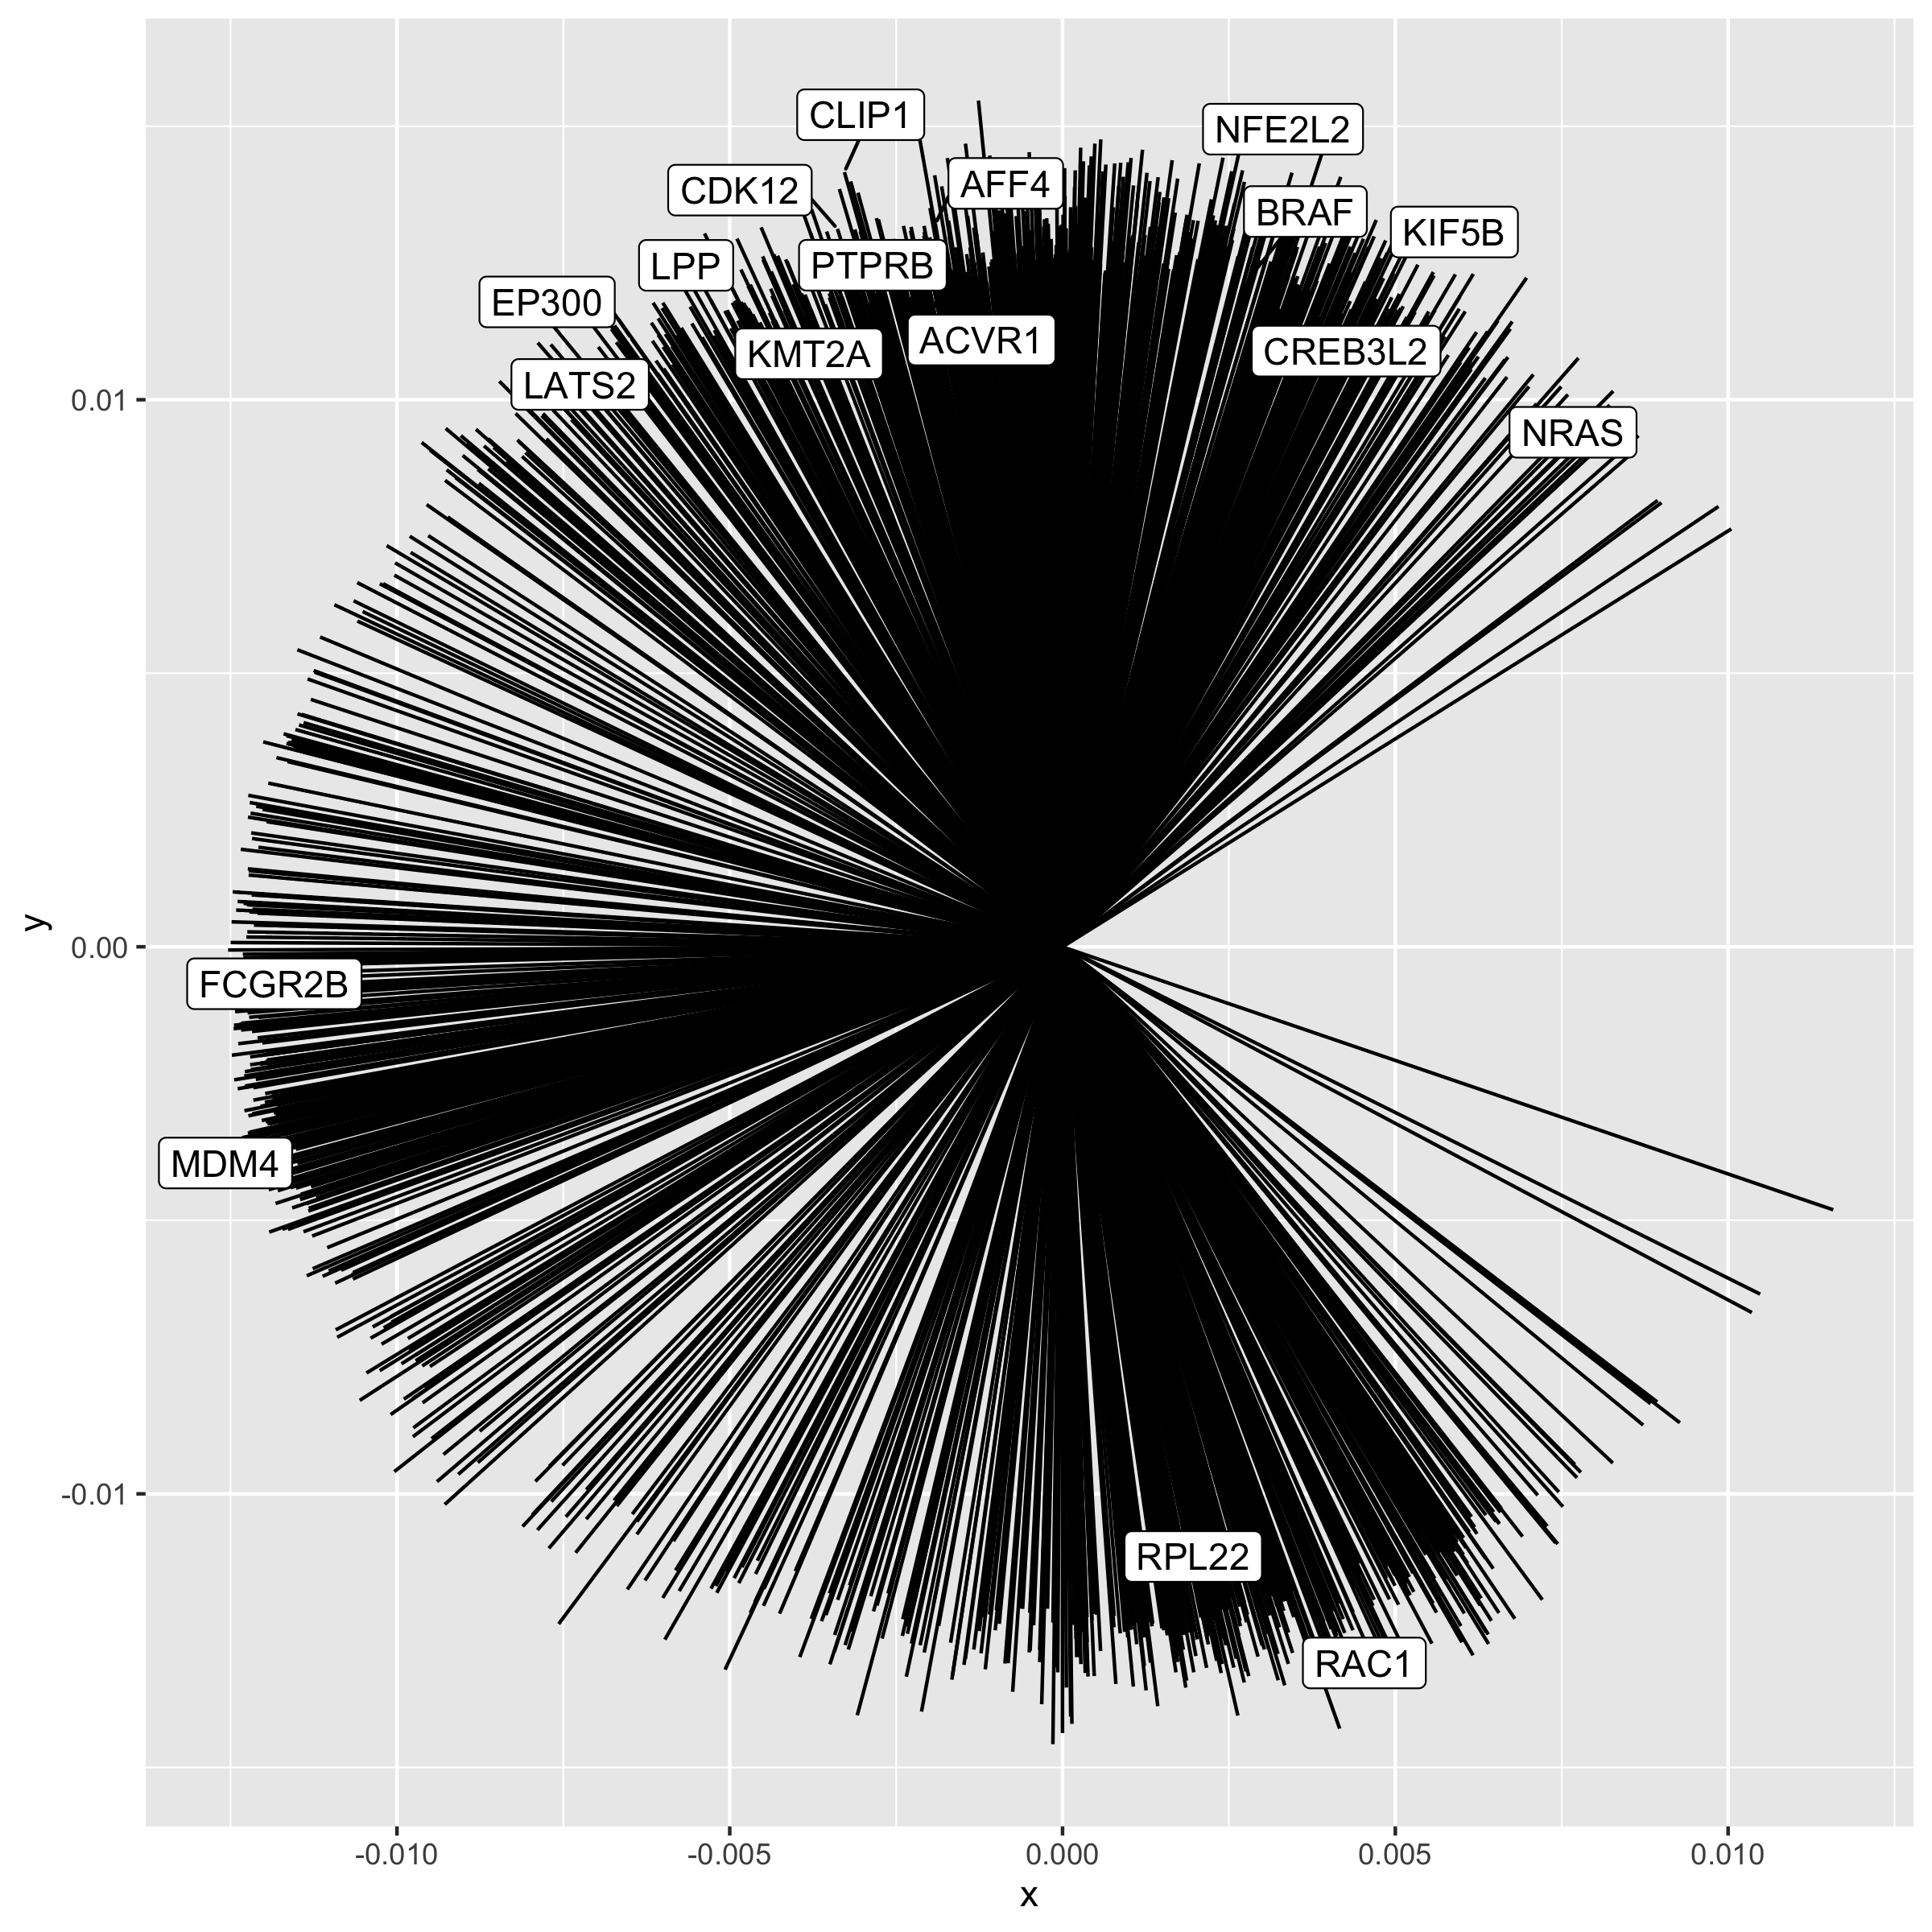
Most variable genes annotated with COSMIC Tier 1 cancer genes

Slide 7
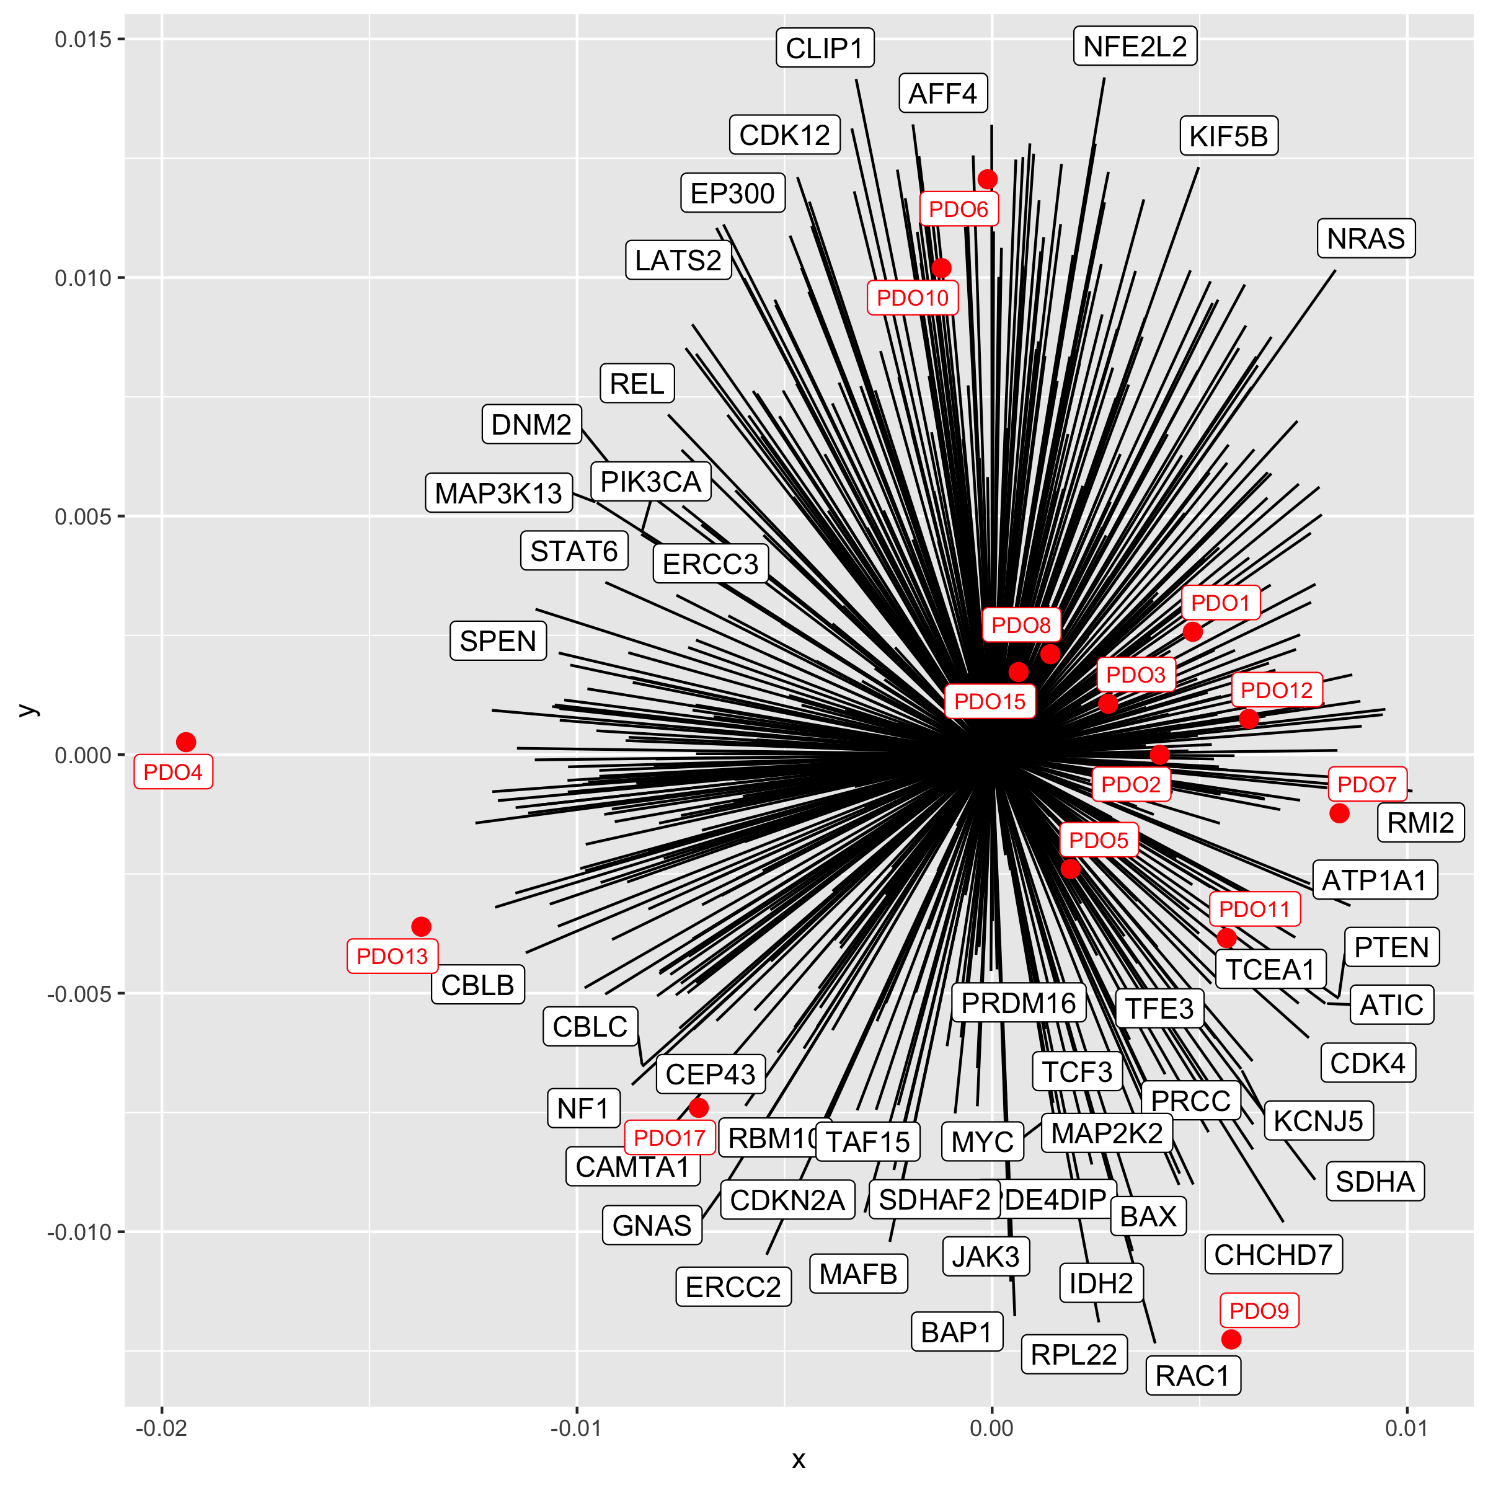
Tier 1 genes and organoids

Slide 8
GO term annotation for ten categories

